Slide 1
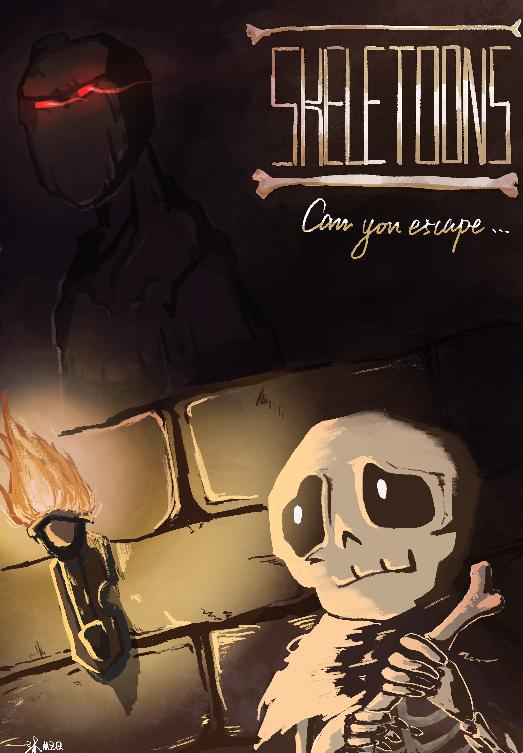
Level Engineering
SKELETOONS
Jonas Niewöhner . Lara Liebmann . Leon Stier . Okay Ünal
Music by:

Slide 2
Gameplay
Insert Video here

Slide 3
Development Process - Jonas
Jonas Slides

Slide 4
Development Process - Lara
Lara Slides

Slide 5
Development Process - Okay
Okay Slides

Slide 6
Level Building – Sketch to Modelling
Insert Pictures maybe

Slide 7
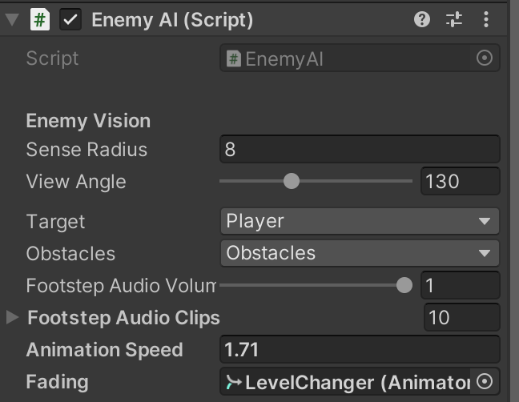
Enemy AI – Core AI and Tool Development
Navmesh Agents
Path specified with Tool
Various Parameter to define
Layer to find Player
Layer to define Objects behind which Player can hide

Slide 8
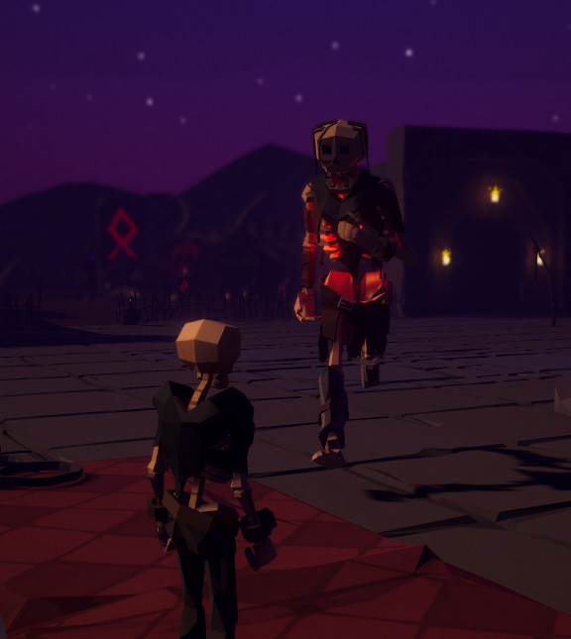
Enemy AI - Behaviour
Walk Path
Scout for Player on Waypoints (Rotate/Look Around)
If sees Player, catch Player
No chance to escape Enemy
Level restarts

Slide 9
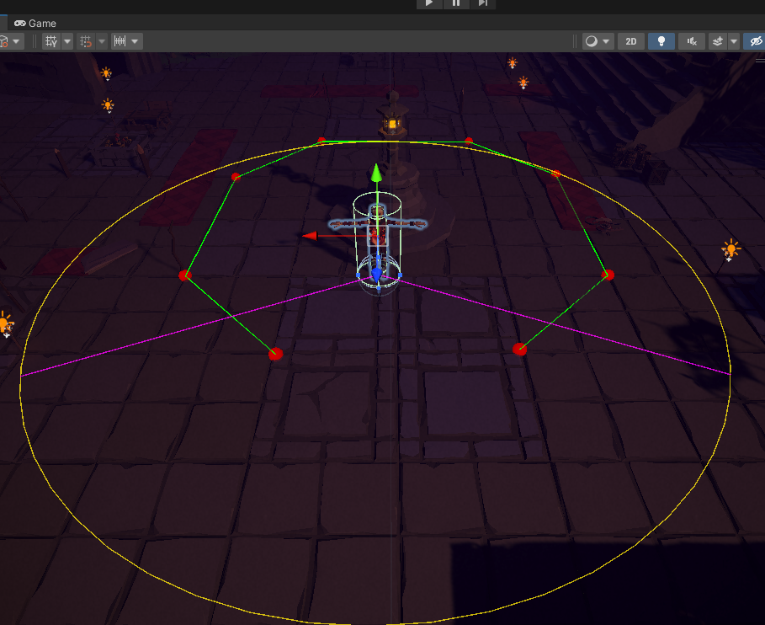
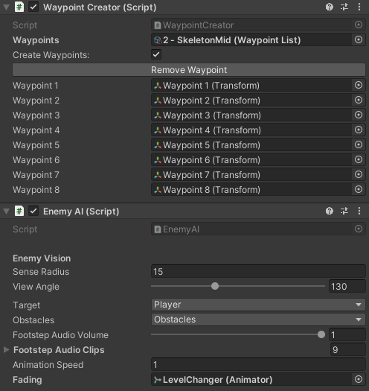
Enemy AI – Visualisation in Scene

Slide 10
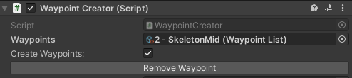
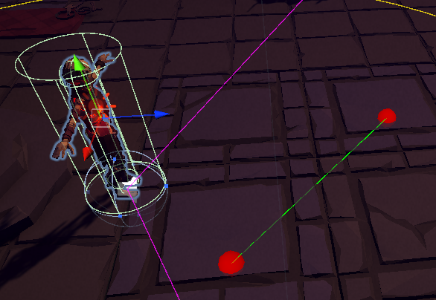

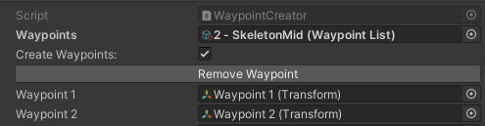
Enemy AI Tool – Intuitive Path Creator
Draw the path of Enemies by clicking it into the scene
Create Scriptable Object to store Path informations
Enable toggle → Leftclick in the Scene View to create a Waypoint

Slide 11
Lighting and Post Processing
Side by Side comparison

Slide 12
Development Process - Leon
Leon Slides

Slide 13
Music Pieces
Insert Music Pieces here

